Slide 1
Using De Novo Ligand Design to Discover Ligands that Bind to HER2 to Inhibit Stomach Cancer
By: Moura Ghattas and Dr. Anderson

Slide 2
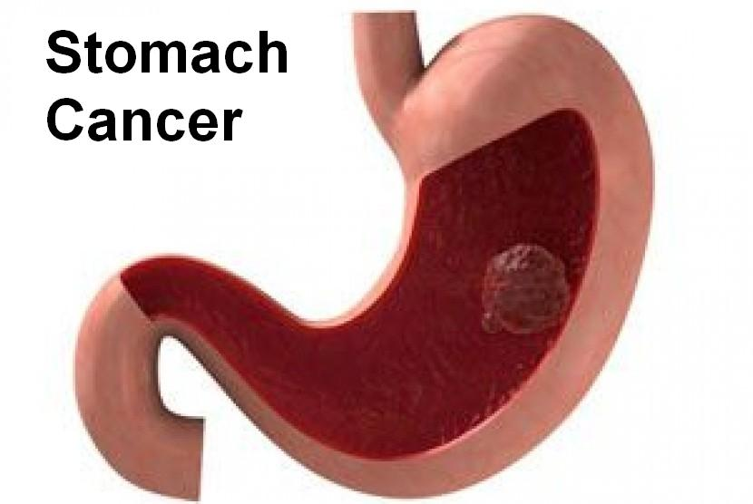
Introduction on Stomach Cancer
Stomach cancer is an abnormal growth of cells that begins in the stomach.
The stomach receives and holds the food we eat which helps to break down and digest the food.
Stomach cancer is often known as gastric cancer.
In most of the world, gastric cancers form in the main part of the stomach.
In the USA, gastric cancers is more likely to affect the area where the esophagus carries the food, we swallow meets the stomach which is called gastroesophageal junction.
Treatment depends on the stage of the cancer, but mostly treatment is extracting the cancer in surgery.

Slide 3
What is HER2?
HER2 is known as human epidermal growth factor receptor 2.
HER2 acts as the expression of a prognostic factor in gastric cancer.
In gastric cancer, HER2 also acts as an oncogene.
HER2 is involved in the pathogenesis and poor outcomes of several types of cancer such as gastric and gastroesophageal junction cancer.

Slide 4
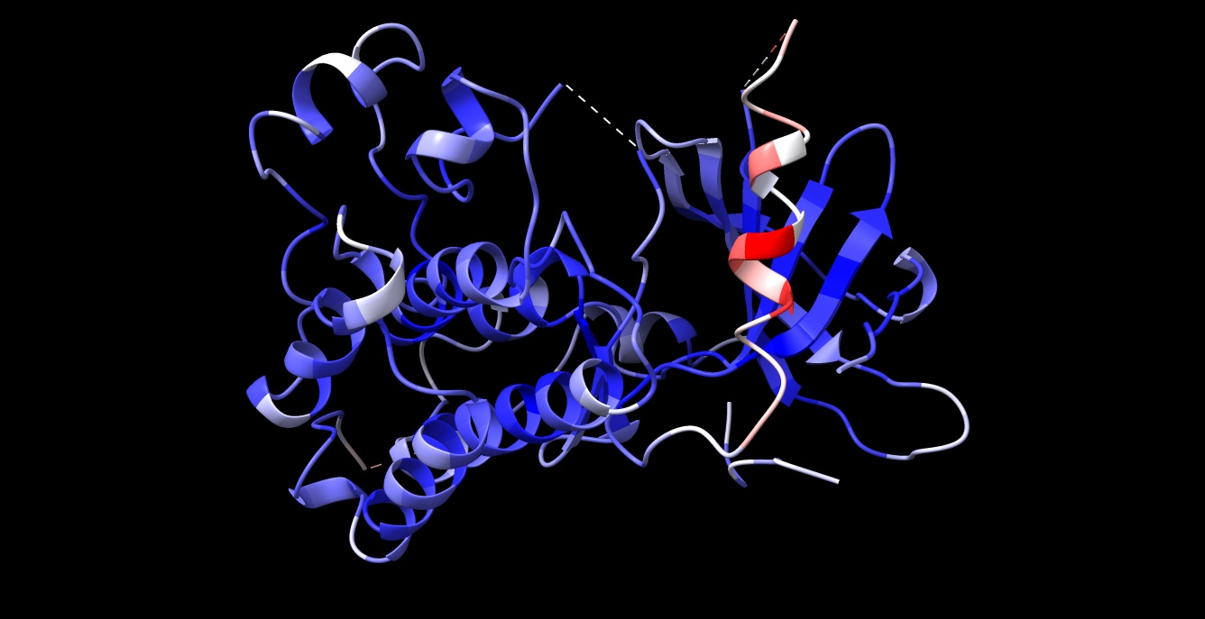
What does HER2 look like?

Slide 5
Research Objective
The objective of this research project was to use DeNovo Ligand to predict which compounds would have high binding affinity to target protein HER2. The predicted compounds could be a potential cure for gastric cancer.

Slide 6
Methods
Pick a disease and a protein.
Run De Novo 11 times with the 3D experimental X-Ray crystal structure.
Calculate the affinity of the 11 compounds.
Dr. Anderson provided me with all my compounds in order to figure out the SMILES structures.
In ADMET, upload the file that has all the compounds. ADMET predicts which compounds are carcinogenic and could be absorbed orally.
After eliminating some ligands due to low GI absorption and low synthesis, the ligands that are high in GI absorption and high synthesis can potentially become pharmaceutical drugs and limit cell growth

Slide 7
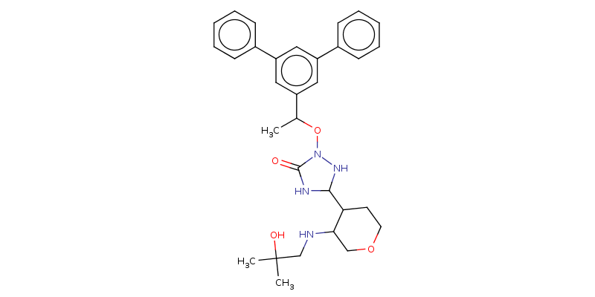
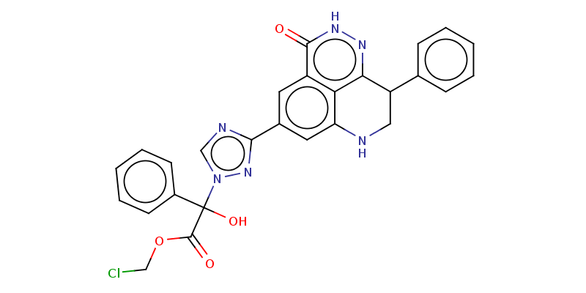
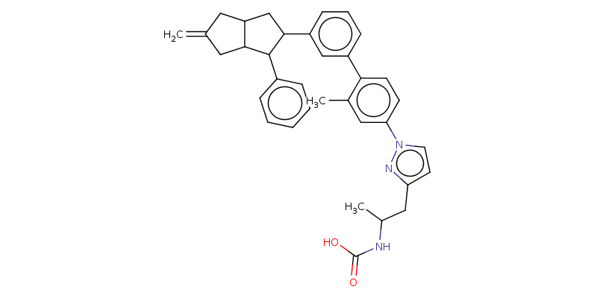
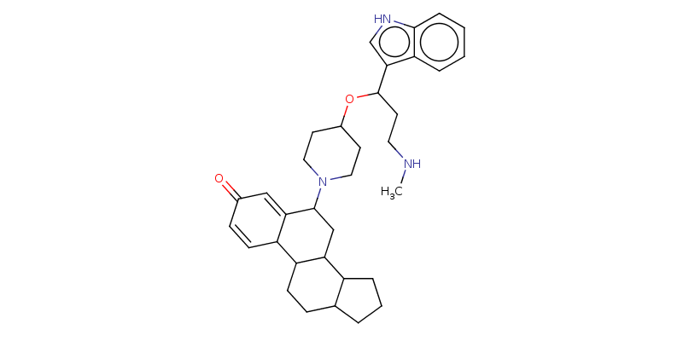
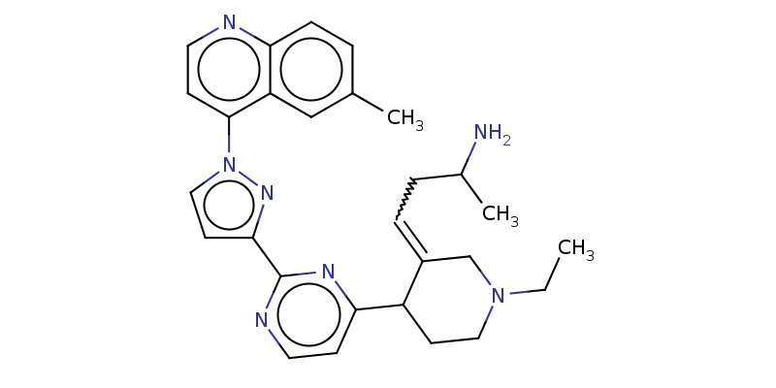
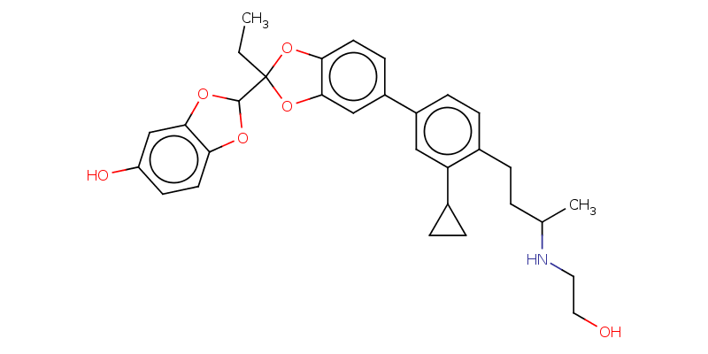
Ligand designs
Ligand 3
Kd: 10 nM
Ligand 1
Kd: 2 nM
Ligand 2
Kd: 4 nM
Ligand 4
Kd: 20 nM
Ligand 5
Kd: 3 nM
Ligand 6
Kd: 2 nM

Slide 8
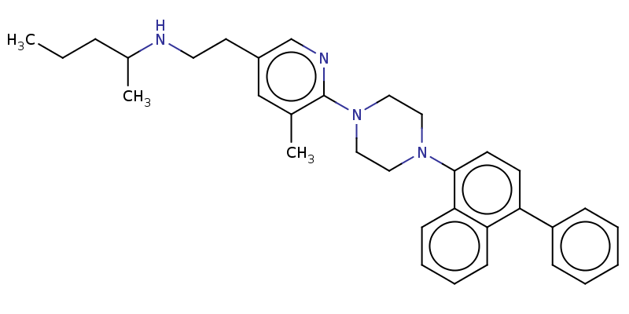
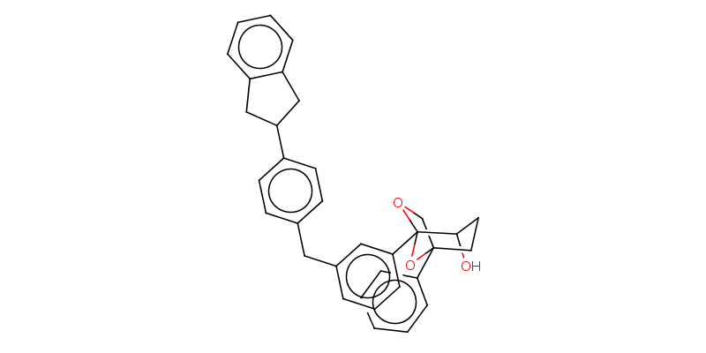
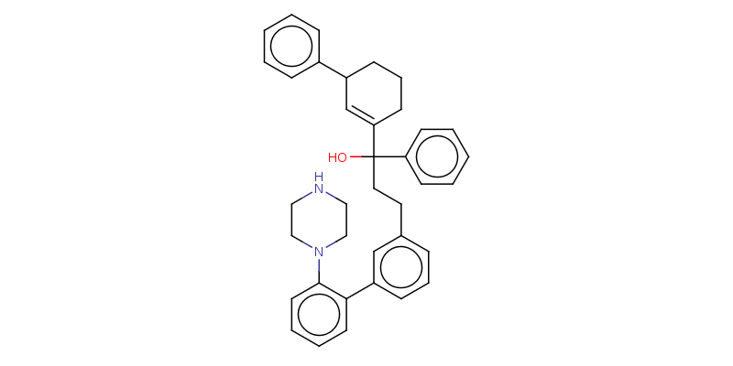
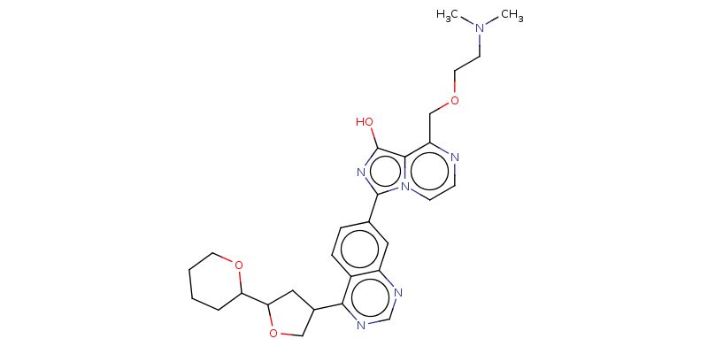
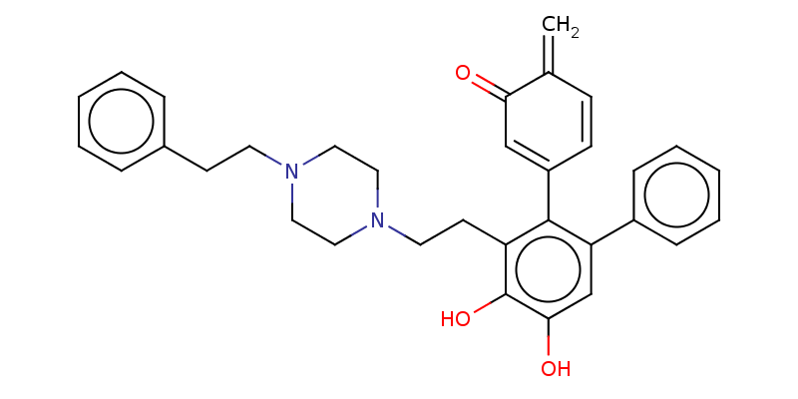
Ligand designs continued
Ligand 8
Kd: 90 nM
Ligand 7
Kd: 9 nM
Ligand 9
Kd: 10 nM
Ligand 11
Kd: 6 nM
Ligand 10
Kd: 20 nM

Slide 9
Results explained
Ligands 1, 4, 5, 7, 8, 9, 10, and 11 all have a category of 1 for Human Intestinal Absorption (HIA). This means that these compounds are predicted to be from the GI tract into the general circulation.
Ligands 1, 2, 3, 5, 6, 7, 8, 9, 10, and 11 all have a category of 0 for Ames Mutagenicity which shows they are not carcinogenic.
Ligands 1, 5, 7, 8, 9, 10, and 11 are successful because they both have a category of 1 for HIA and a category of 0 for mutagenicity.

Slide 10
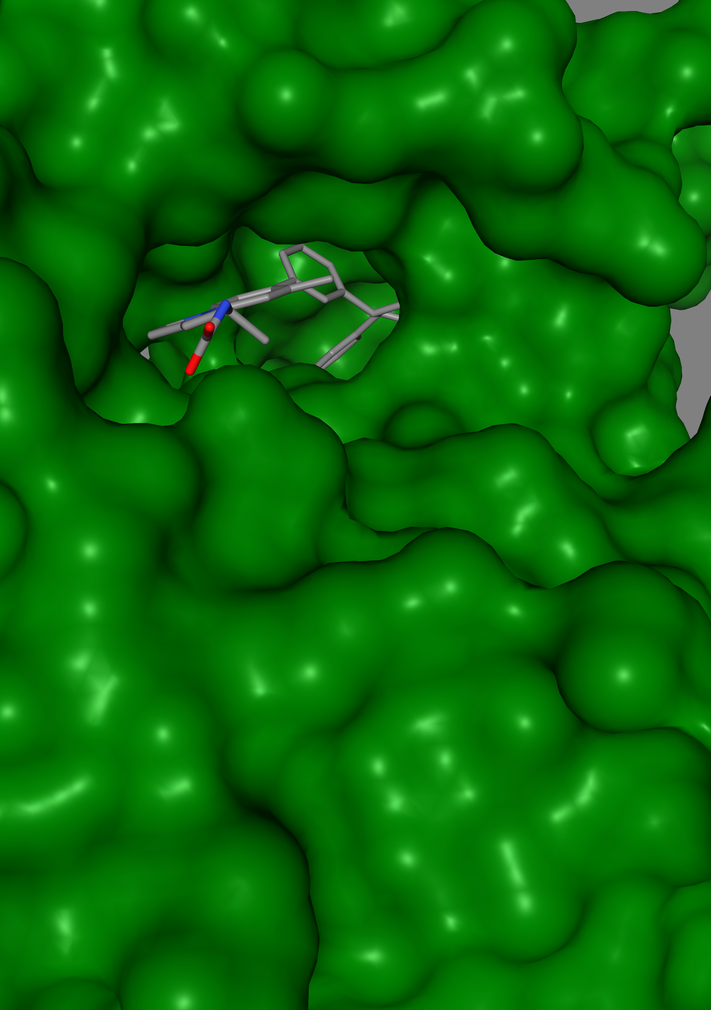
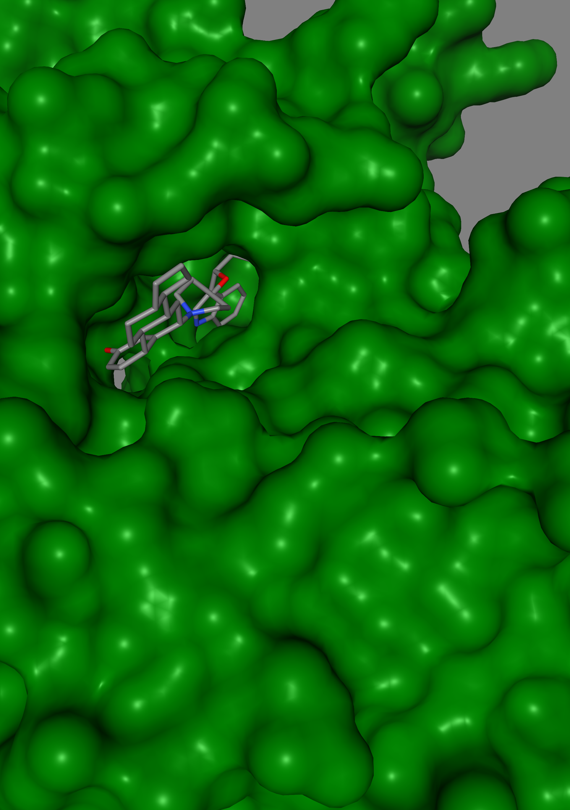
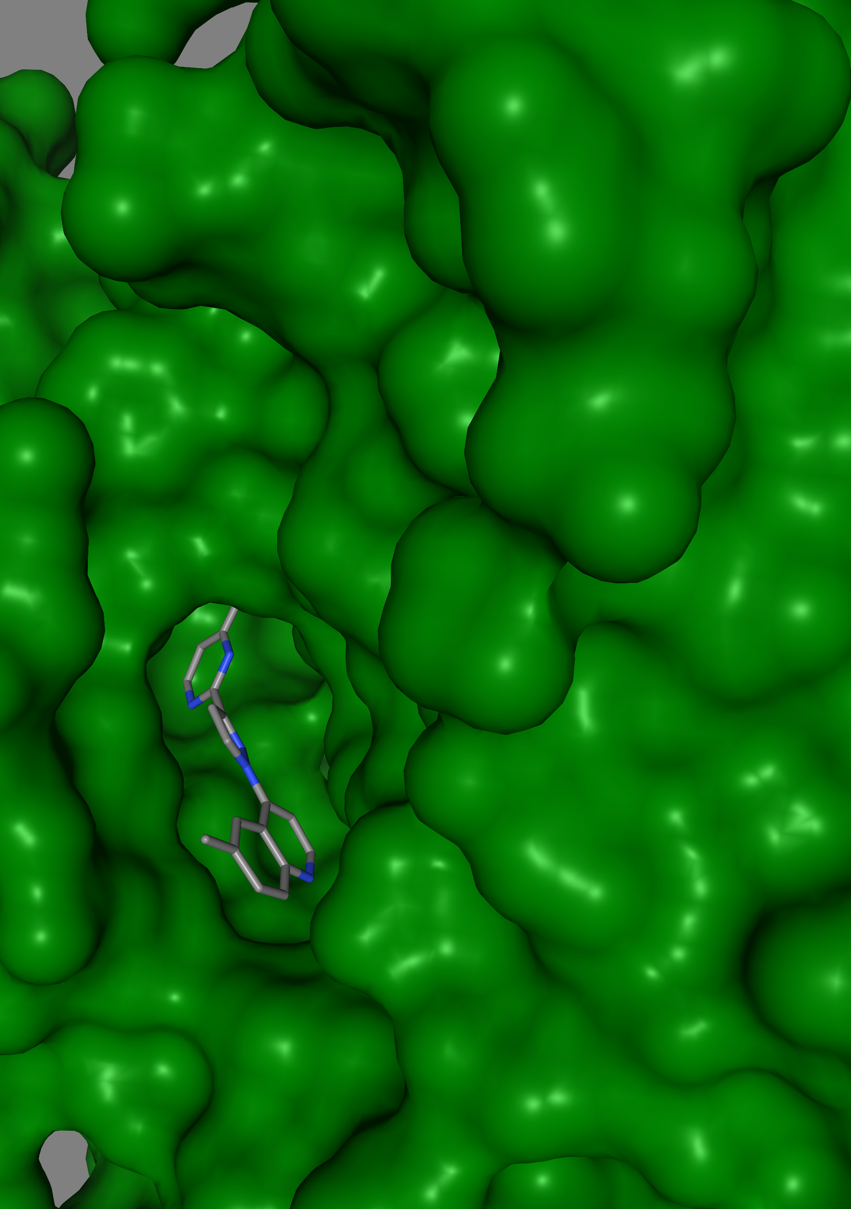
Protein with inhibitor
Ligand 1
Ligand 2
Ligand 3

Slide 11
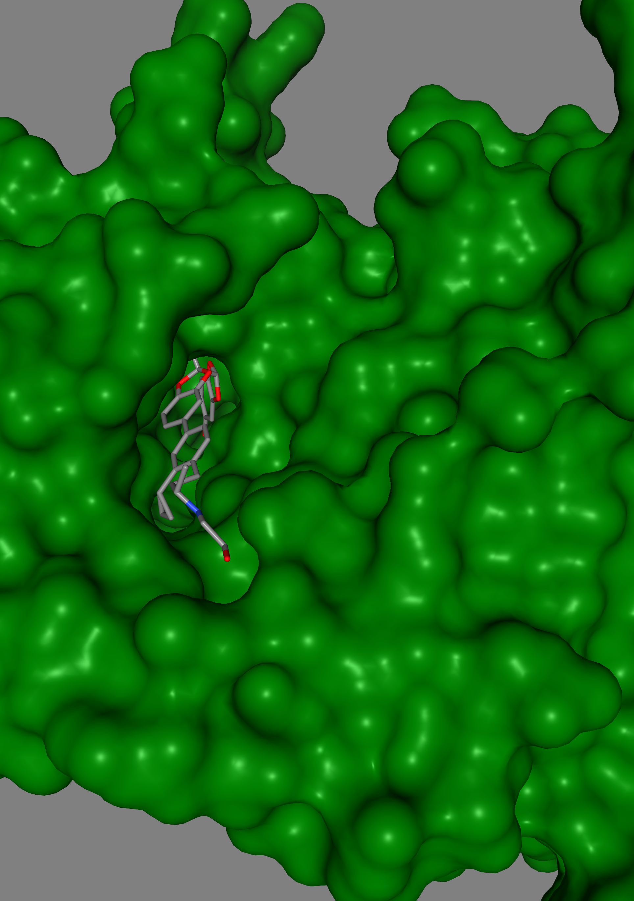
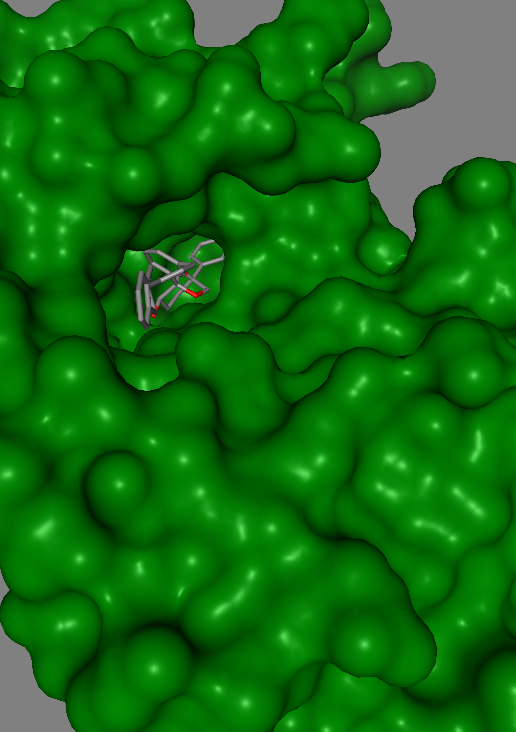
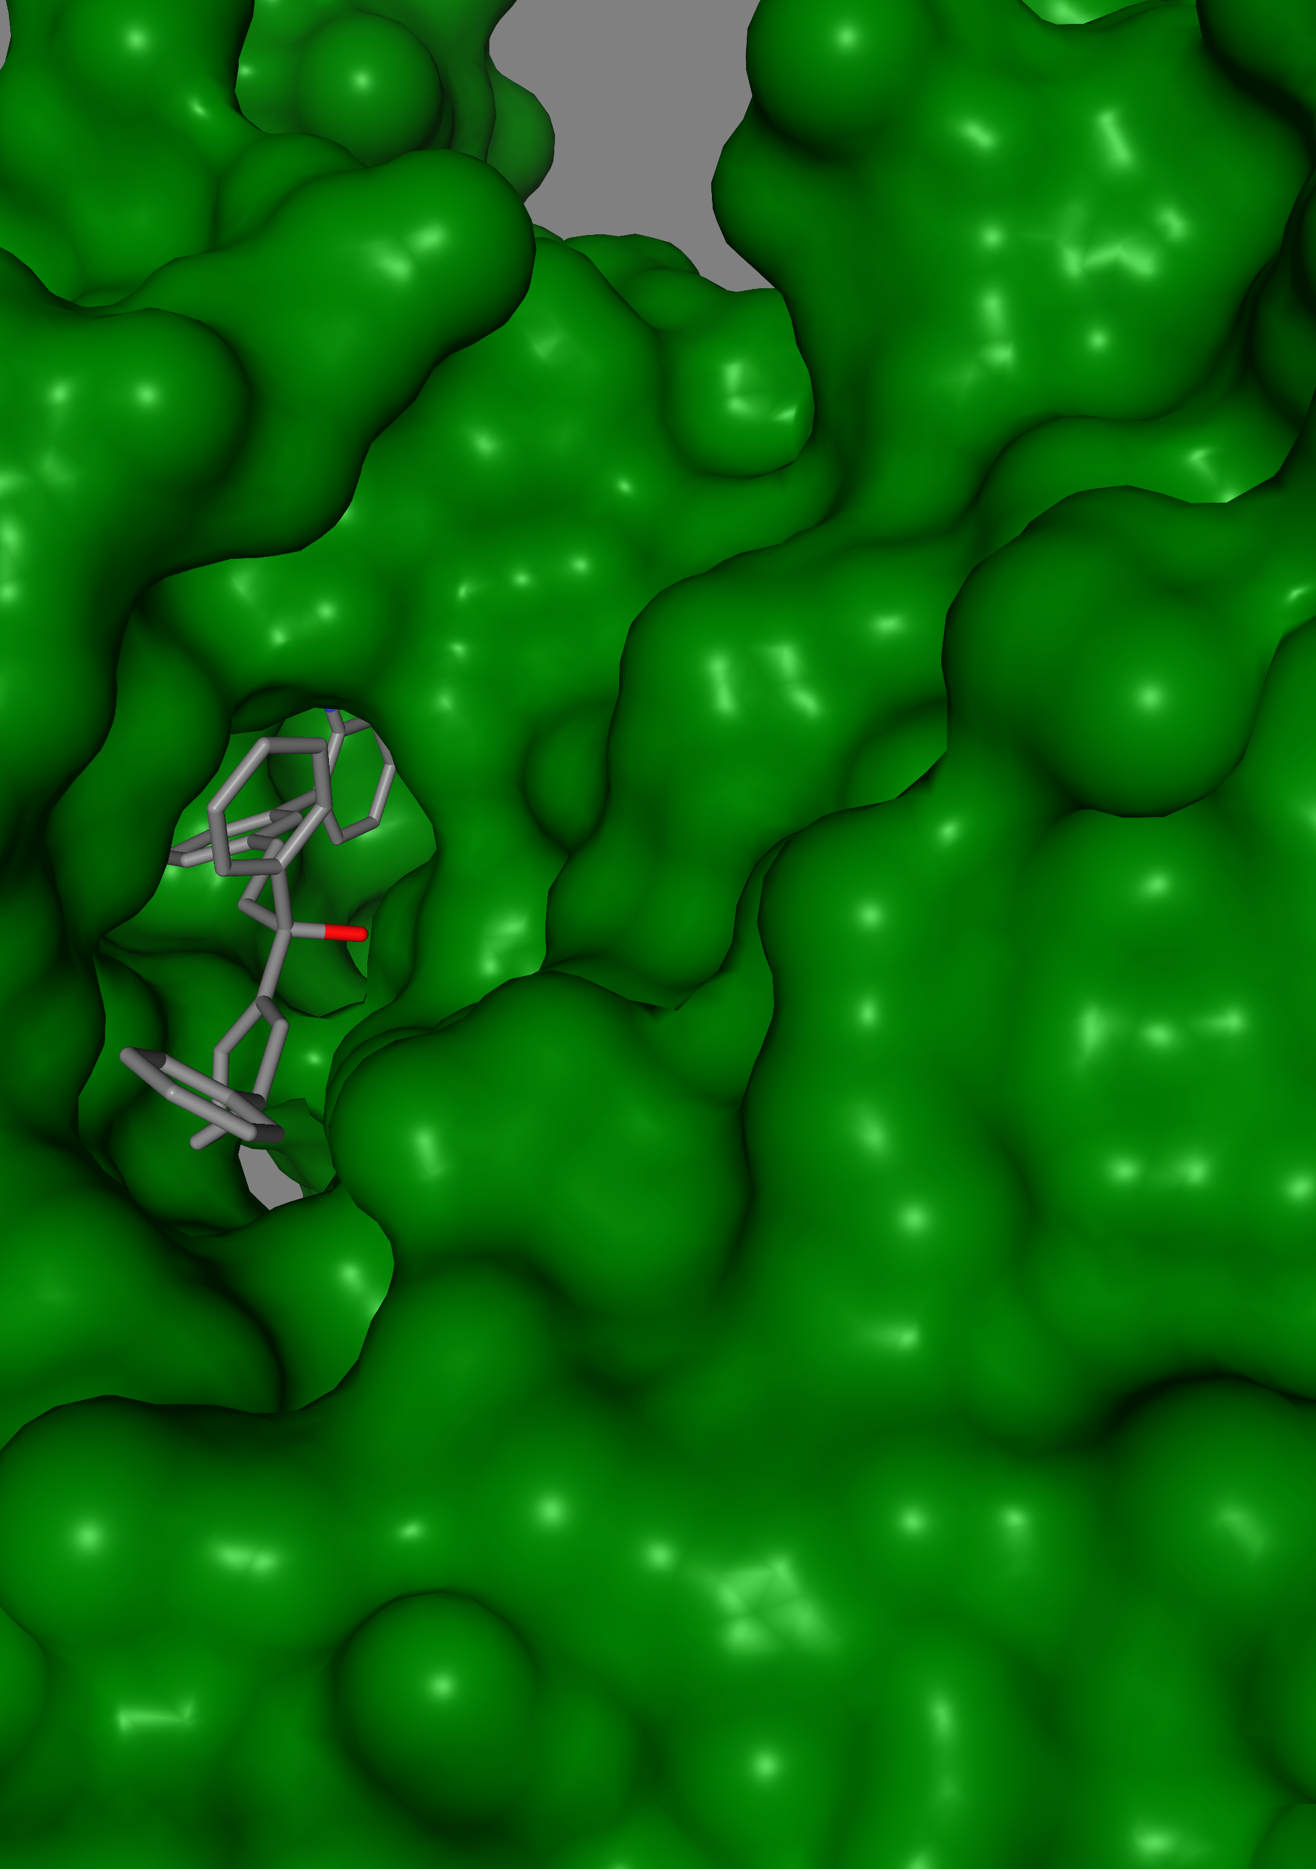
Protein with inhibitor continued
Ligand 4
Ligand 5
Ligand 6

Slide 12
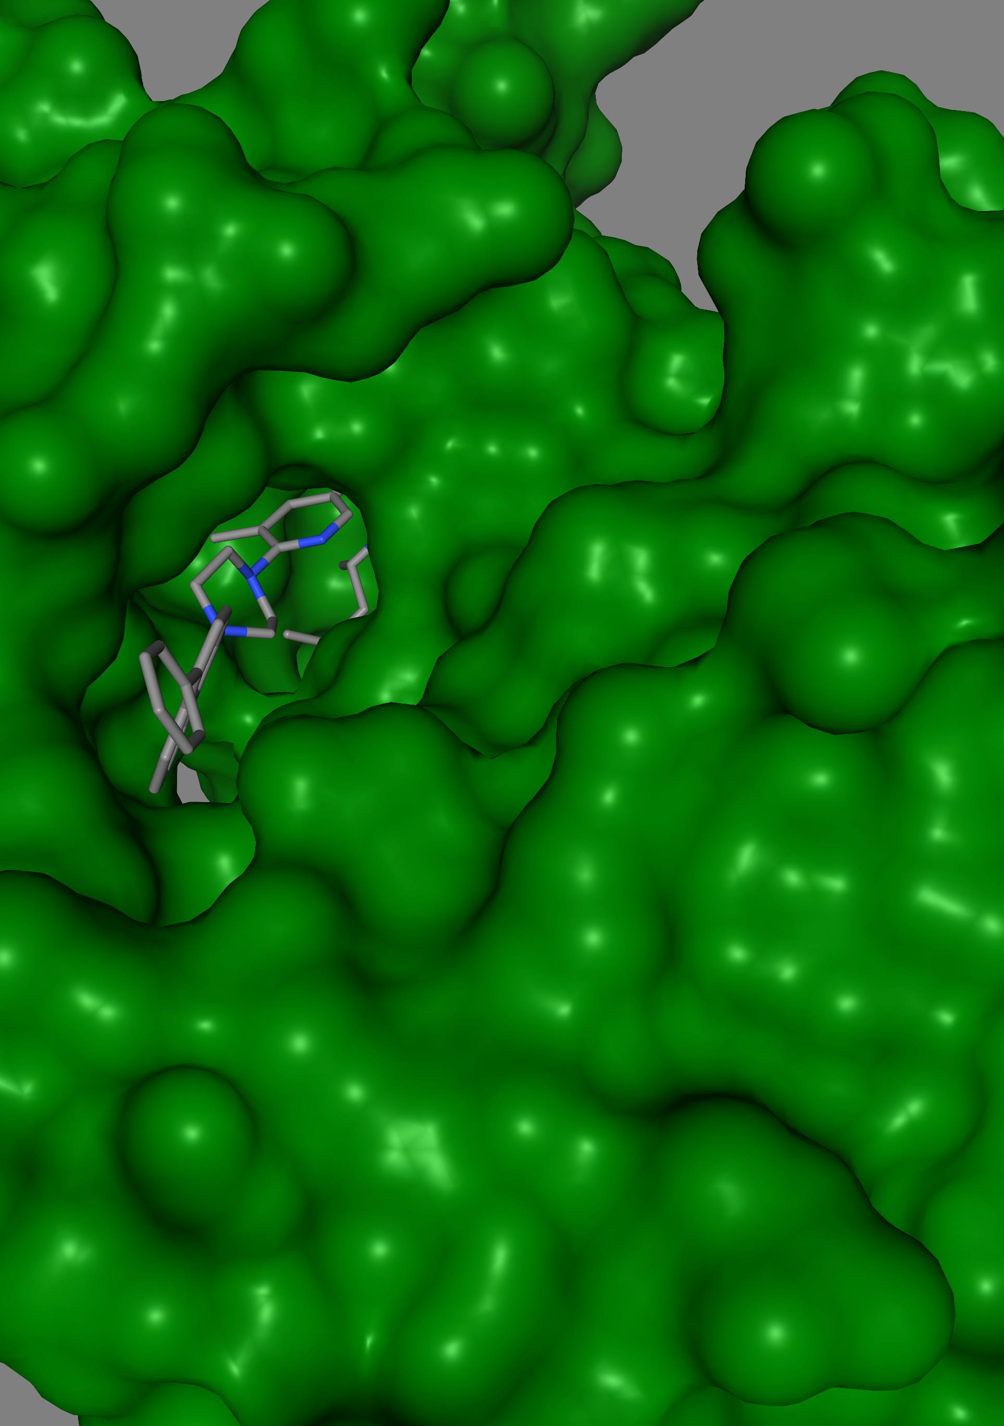
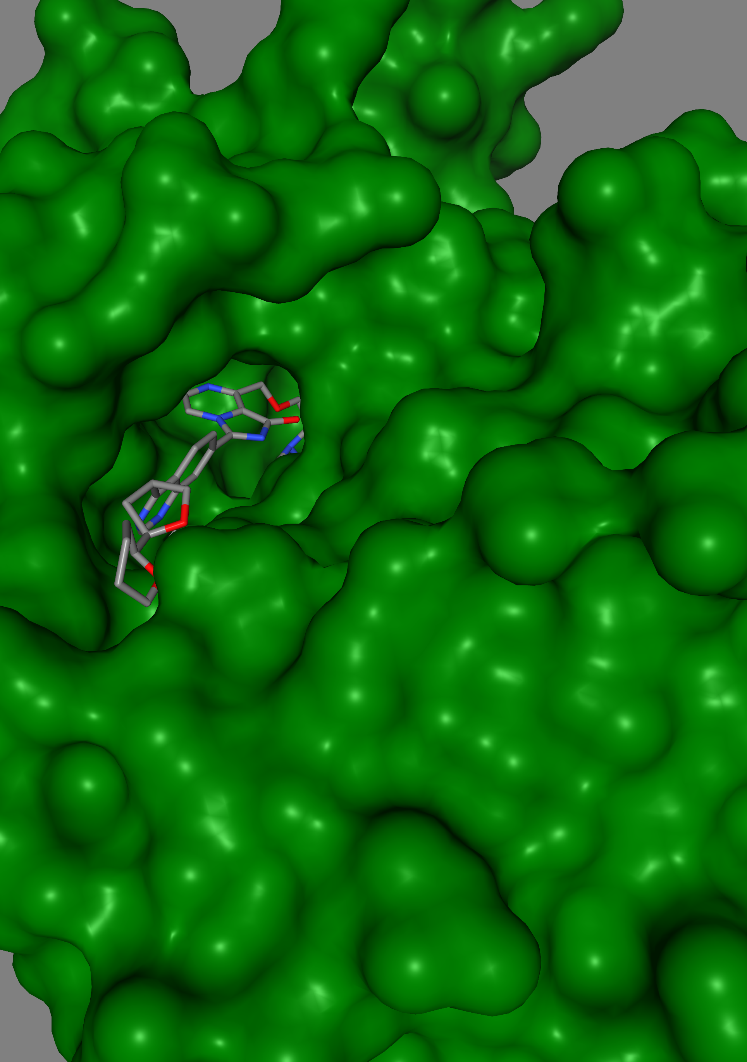
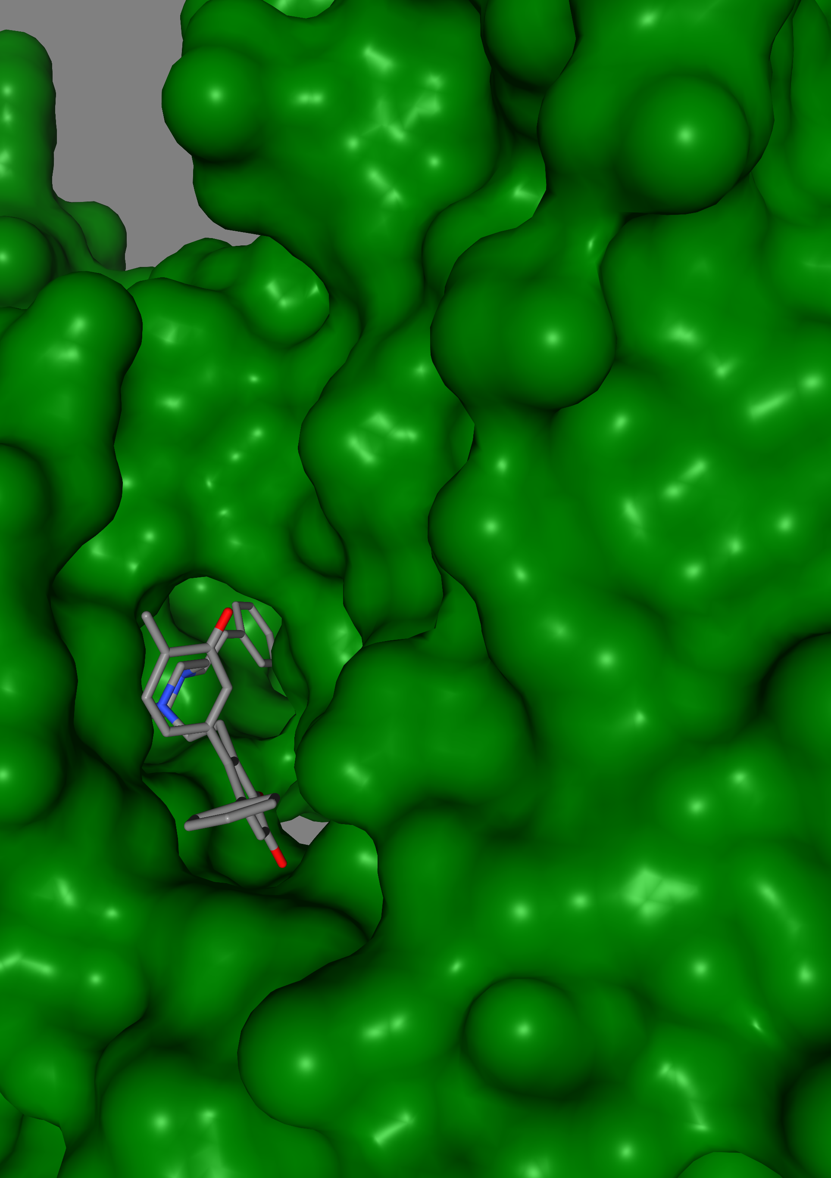
Protein with inhibitor continued
Ligand 7
Ligand 8
Ligand 9

Slide 13
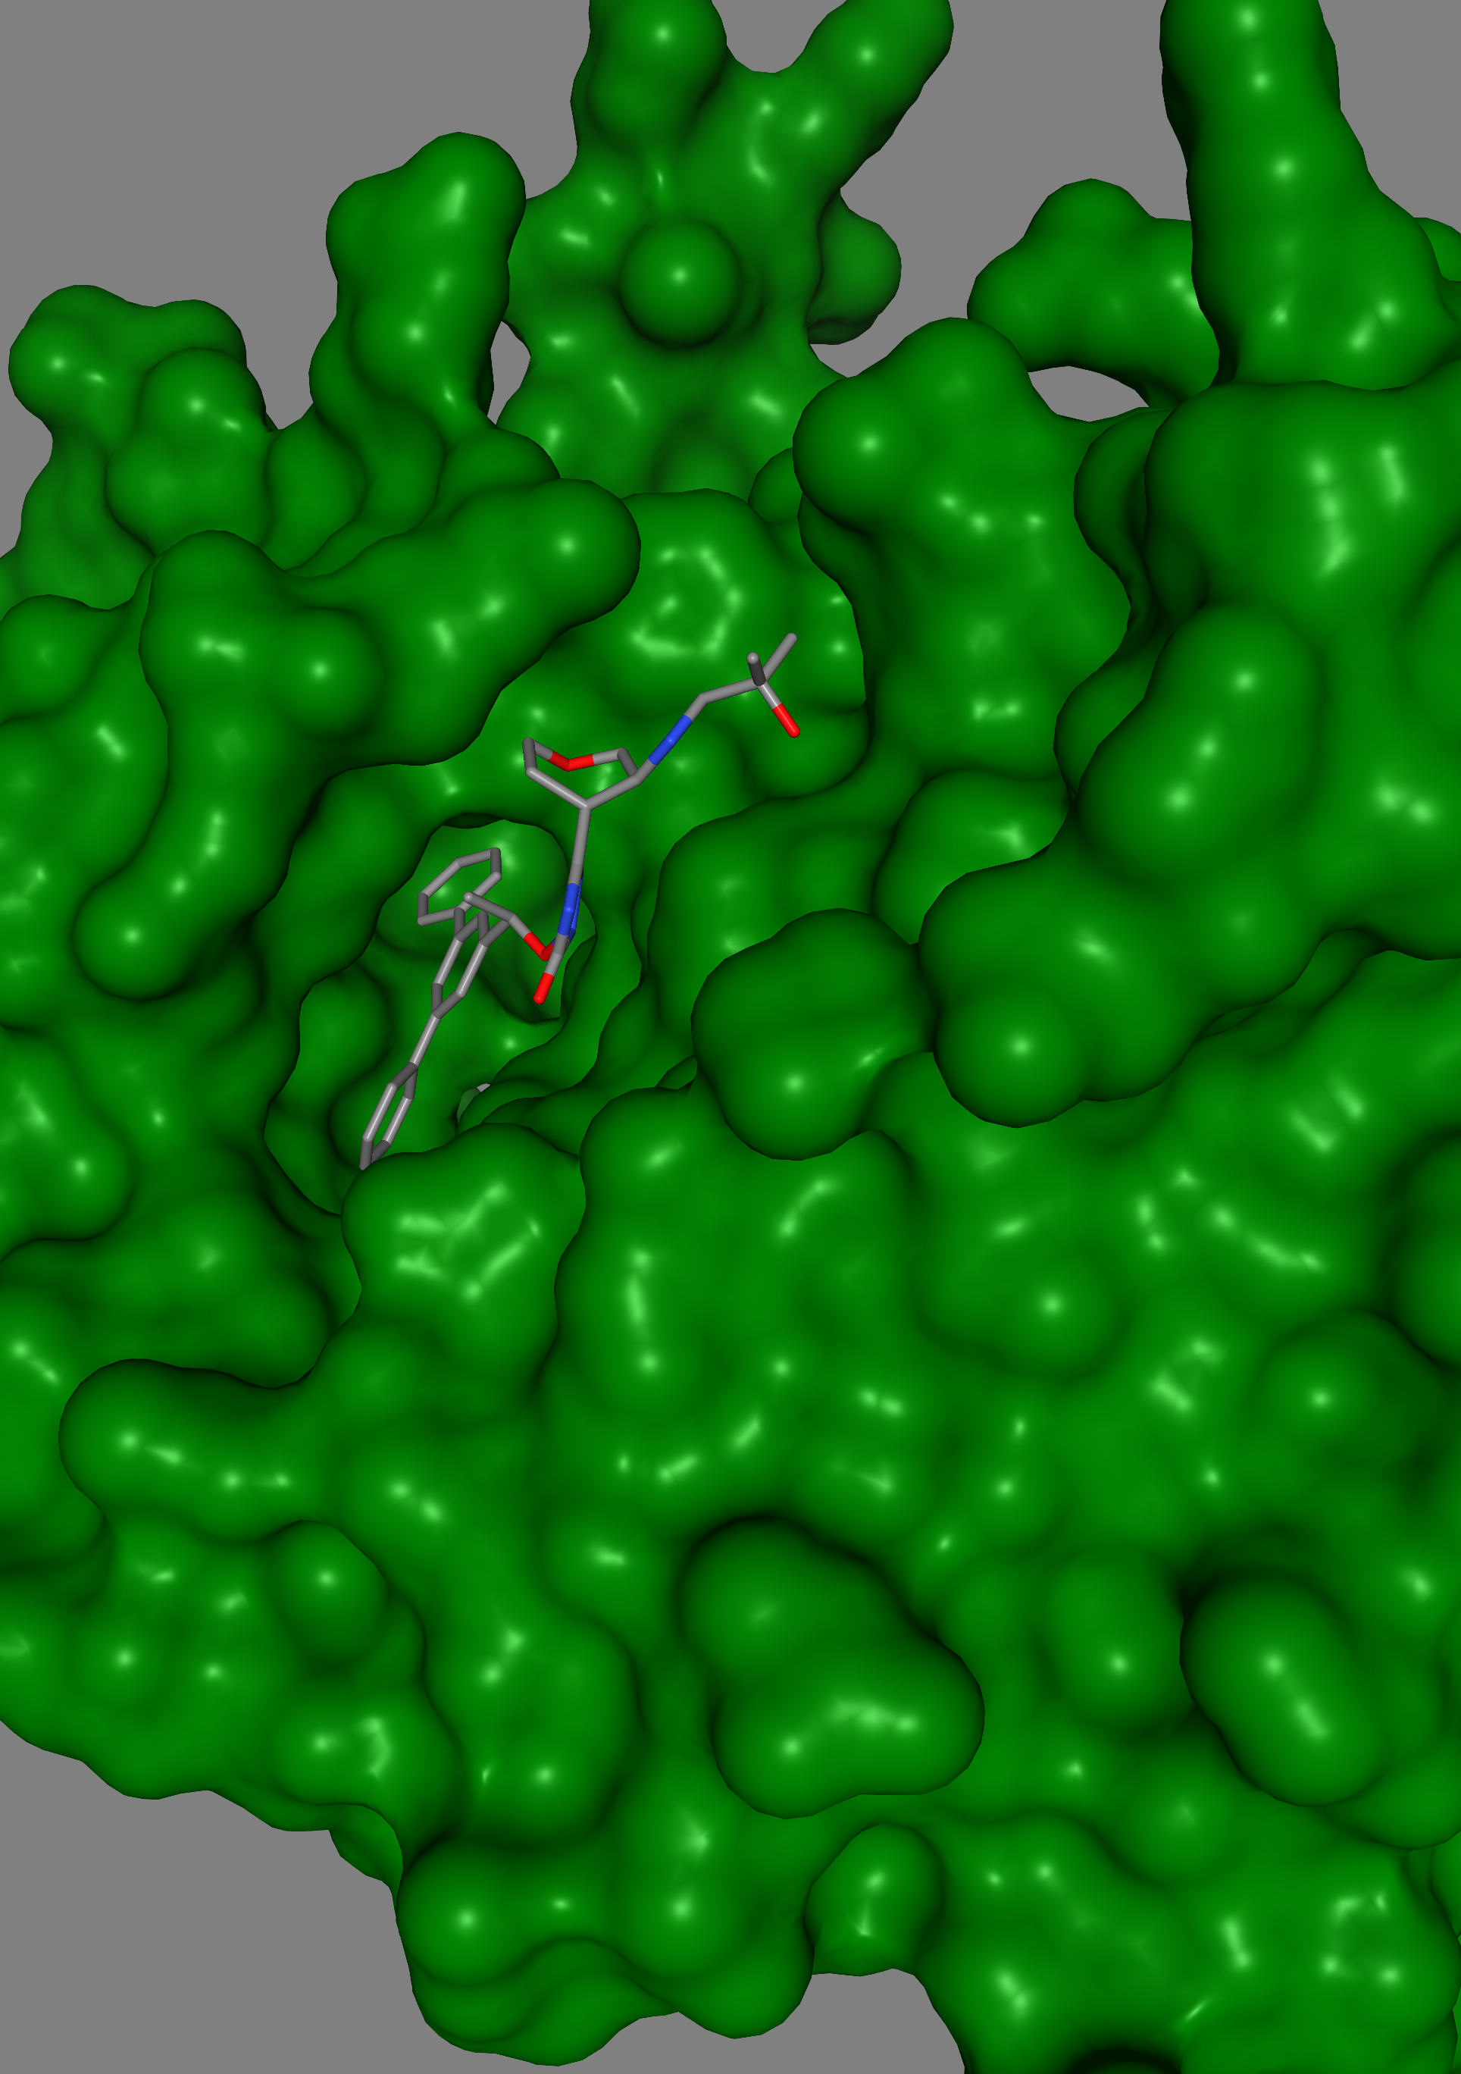
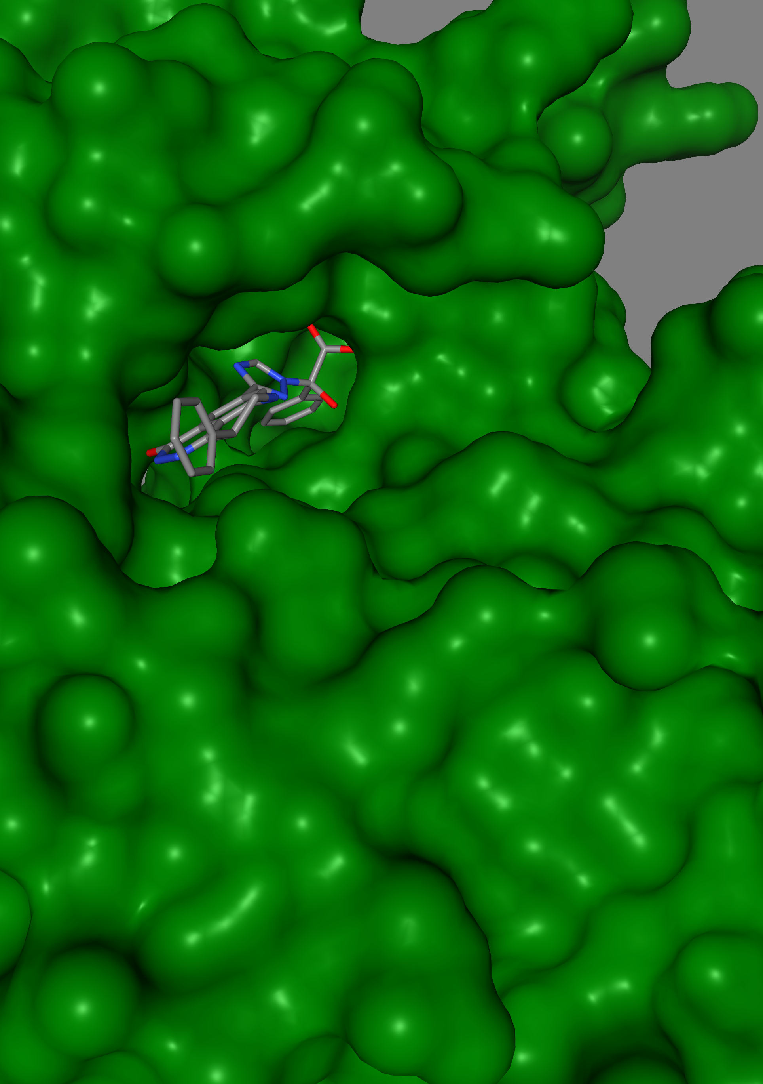
Protein with inhibitor continued
Ligand 11
Ligand 10

Slide 14
Conclusion
All 11 ligands have high affinity since they are all below 1000 nm.
6 of the 11 ligands could be orally consumed to inhibit HER2 since they are not carcinogenic and can be absorbed intestinally.
The other 5 ligands could be injected to inhibit HER2.

Slide 15
References
“Stomach Cancer - Symptoms and Causes.” Mayo Clinic, 2018, www.mayoclinic.org/diseases-conditions/stomach-cancer/symptoms-causes/syc-20352438.
“Annals of Oncology.” Www.journals.elsevier.com, www.journals.elsevier.com/annals-of-oncology#:~:text=HER2%20expression%20as%20a%20prognostic%20factor%20in%20gastric. Accessed 17 May 2021.
Boku, Narikazu. “HER2-Positive Gastric Cancer.” Gastric Cancer, vol. 17, no. 1, 7 Apr. 2013, pp. 1–12, www.ncbi.nlm.nih.gov/pmc/articles/PMC3889288/pdf/10120_2013_Article_252.pdf, 10.1007/s10120-013-0252-z. Accessed 2 May 2019.

